Slide 1
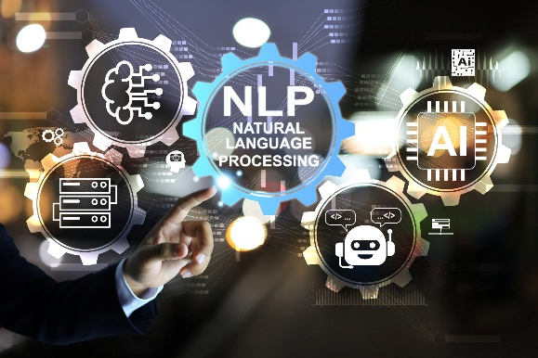

Dr. Muzamil Ahmed (Assistant Professor) Namal University Mianwali
Natural Language Processing
BERT
Bidirectional Encoder Representations from Transformers

Slide 2

Lesson from Quran

Slide 3

Lecture Outline
Bidirectional Transformer Encoders
Pre-training and Fine-tuning
Training Bidirectional Encoders (MLM)
Fine-Tuning
Sentiment Classification
BERT Size & Architecture
Other Langugae Models
Summary

Slide 4
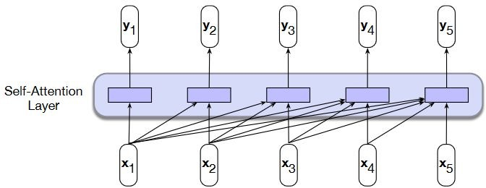
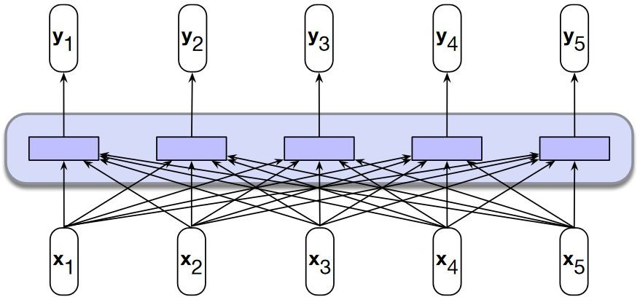
Bidirectional Transformer Encoders
The focus of bidirectional encoders is on computing contextualized representations of the tokens in an input sequence that are generally useful across a range of downstream applications
backward looking, transformer model
bidirectional transformer model
16

Slide 5
Overview
BERT makes use of Transformer, an attention mechanism that learns contextual relations between words (or sub-words) in a text
An encoder that reads the text input and a decoder that produces a prediction for the task. Transformer encoder reads the entire sequence of words at once
Since BERT’s goal is to generate a language model, only the encoder mechanism is necessary
Devlin et al. BERT: Pre-training of Deep Bidirectional Transformers for Language Understanding, 2019
17

Slide 6
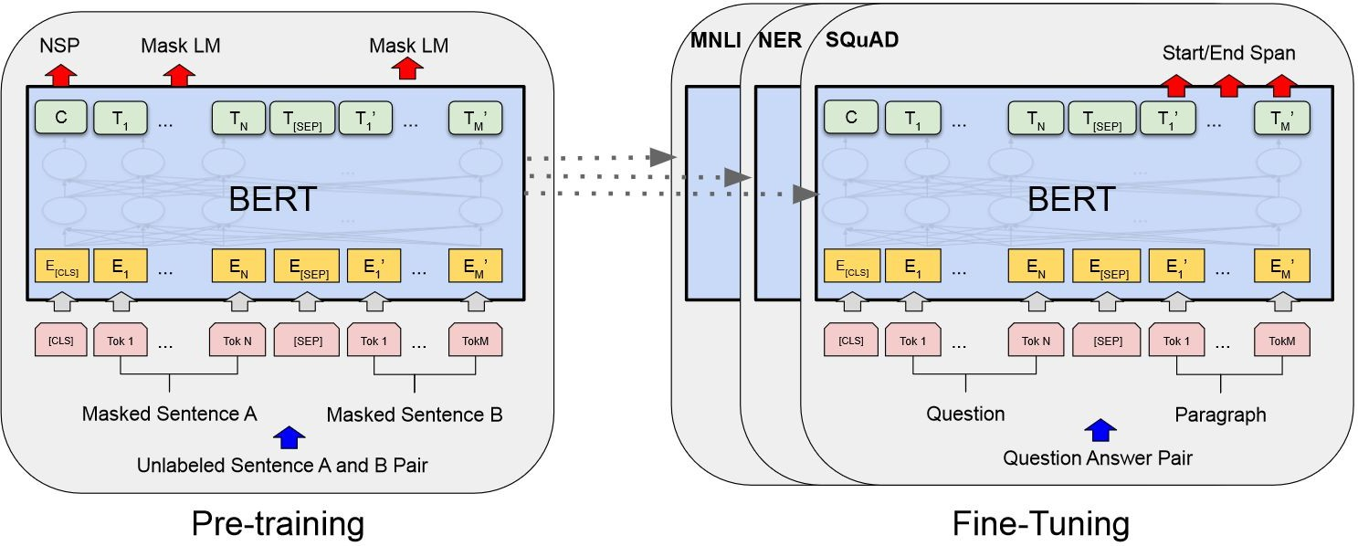
Pre-training and Fine-tuning
The same architectures are used in both pre-training and fine-tuning
[CLS]is a special symbol added in front of every input example, and [SEP]is a special separator token
Pre-training: two tasks are considered
Masked LM: mask some percentage of the input tokens at random, and then predict those masked tokens Mask 15% of all WordPiece tokens in each sequence at random
Next Sentence Prediction: understanding the relationship between two sentence (50% of positive pairs) Used BooksCorpus (800M words) and Wikipedia (2,500M words)

Slide 7
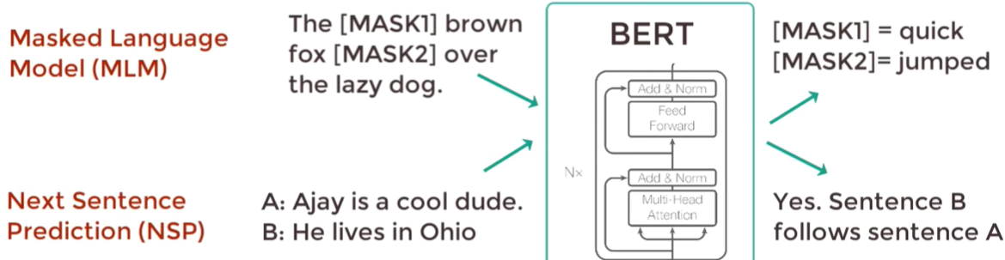
Pre-training

Slide 8
Training Bidirectional Encoders (MLM)
The original approach to training bidirectional encoders is called Masked Language Modeling (MLM)
MLM uses unannotated text from a large corpus
Model is presented with a series of sentences from the training corpus, where a random sample of tokens from each training sequence is selected for use in the learning task. Once chosen, a token is used in one of three ways:
It is replaced with the unique vocabulary token [MASK]
It is replaced with another token from the vocabulary, randomly sampled based on token unigram probabilities
It is left unchanged
In BERT, 15% of the input tokens in a training sequence are sampled for learning
Of these, 80% are replaced with [MASK], 10% are replaced with randomly selected tokens, and the remaining 10% are left unchanged

Slide 9
Training Bidirectional Encoders (MLM)
The MLM training objective is to predict the original inputs for each of the masked tokens using a bidirectional encoder of the kind described in the last section
The cross-entropy loss from these predictions drives the training process for all the parameters in the model
Note that all the input tokens play a role in the self-attention process, but only the sampled tokens are used for learning
Input:
Original input sequence is first tokenized using a subword model
The sampled items which drive the learning process are chosen from among the set of tokenized inputs
Word embeddings for all the tokens in the input are retrieved from the word embedding matrix and then combined with positional embeddings to form the input to the transformer

Slide 10
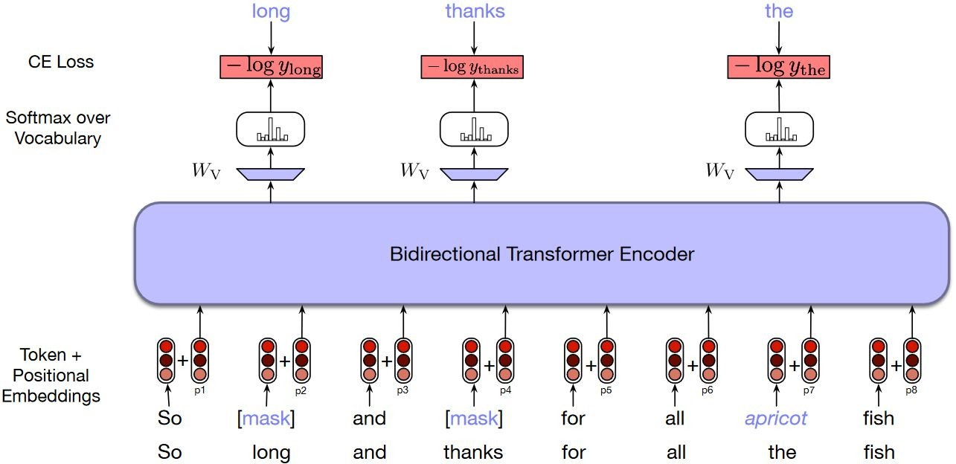
Training Bidirectional Encoders (MLM)
long, thanks and the have been sampled from the training sequence, with the first two masked and the replaced with the randomly sampled token apricot

Slide 11
Training Bidirectional Encoders (NSP)
An important class of applications involves determining the relationship between pairs of sentences
paraphrase detection (detecting if two sentences have similar meanings)
entailment (detecting if the meanings of two sentences entail or contradict each other)
discourse coherence (deciding if two neighboring sentences form a coherent discourse)
To capture the kind of knowledge required for applications such as these, BERT introduced a second learning objective called Next Sentence Prediction (NSP)
Training: The model is presented with pairs of sentences and is asked to predict whether each pair consists of an actual pair of adjacent sentences from the training corpus or a pair of unrelated sentences

Slide 12
Training Bidirectional Encoders (NSP)
In BERT, 50% of the training pairs consisted of positive pairs, and in the other 50% the second sentence of a pair was randomly selected from elsewhere in the corpus
The NSP loss is based on how well the model can distinguish true pairs from random pairs
BERT introduces two new tokens to the input representation
After tokenizing the input with the subword model, the token [CLS] is prepended to the input sentence pair, and the token [SEP] is placed between the sentences and after the final token of the second sentence
During training, the output vector from the final layer associated with the [CLS]
token represents the next sentence prediction

Slide 13
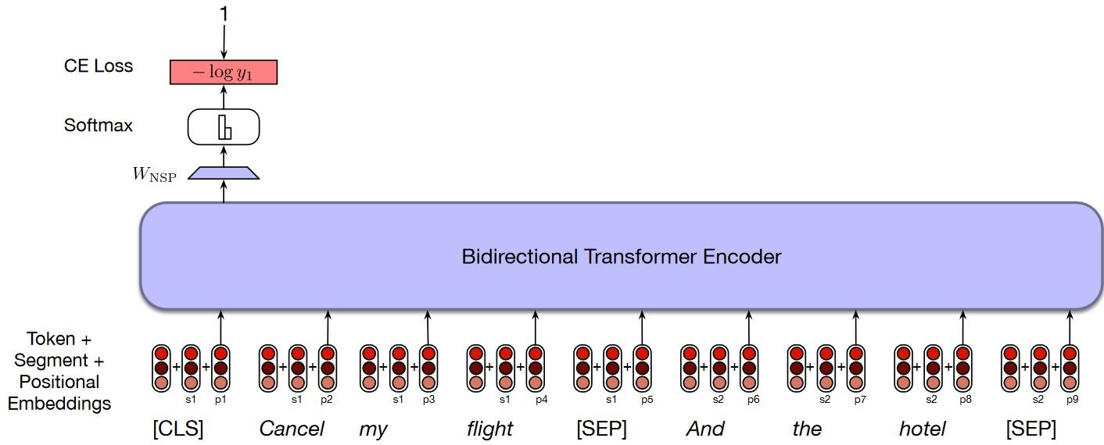
Training Bidirectional Encoders (NSP)

Slide 14
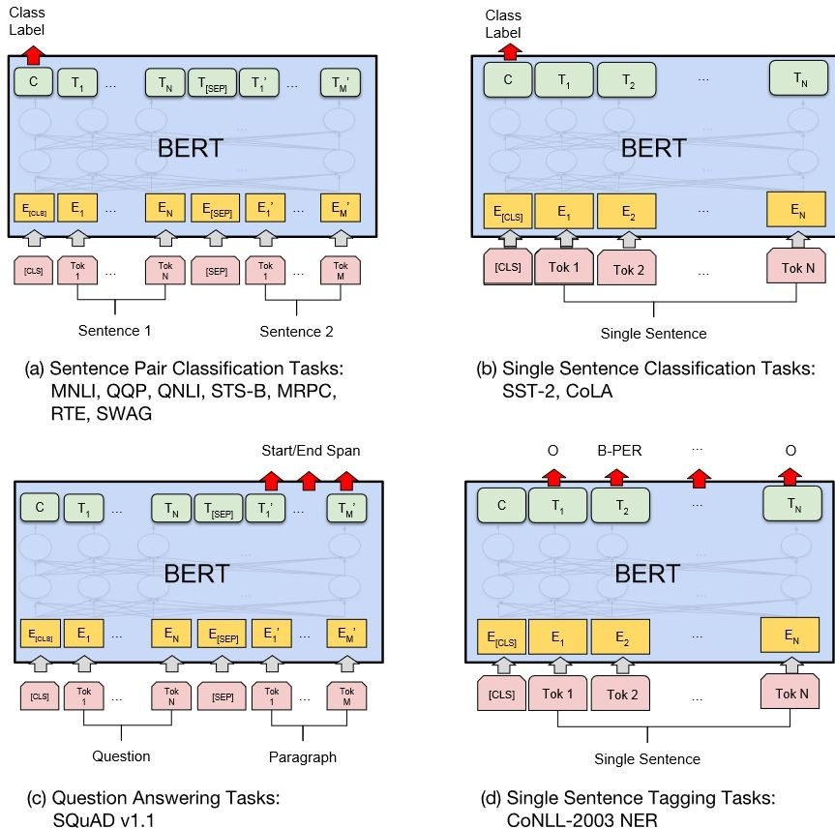
Fine-Tuning
Compared to pre-training, fine-tuning is relatively inexpensive
Most model hyperparameters are the same as in pre-training, except for parameters such as number of training epochs
Tasks:
Question answering
Abstract summarization
Sentence prediction
Conversational response generation
Sentiment classification

Slide 15

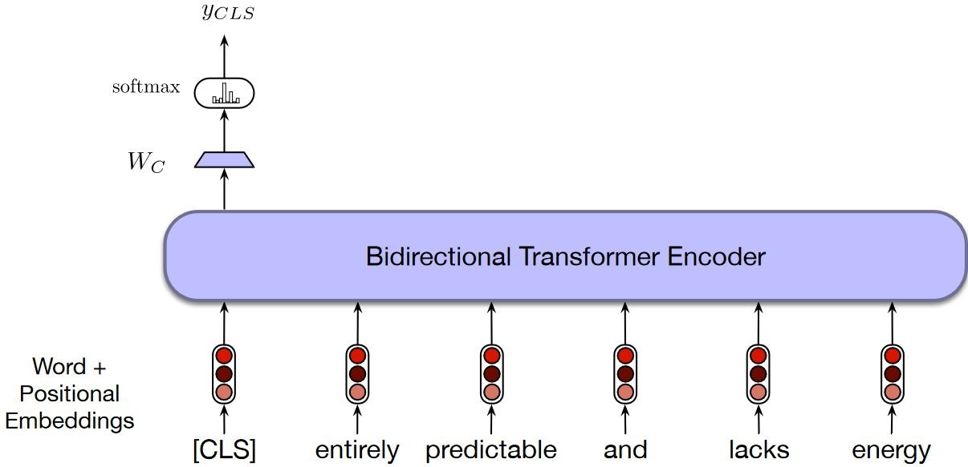
Sentiment Classification
y_{CLS} to a set of scores over the possible sentiment classes
Learning a set of weights, W_{C}, to map the output vector for the [CLS] token, y_{CLS}
The output vector in the final layer of the model for the [CLS] input represents the entire input sequence and serves as the input to a classifier head

Slide 16
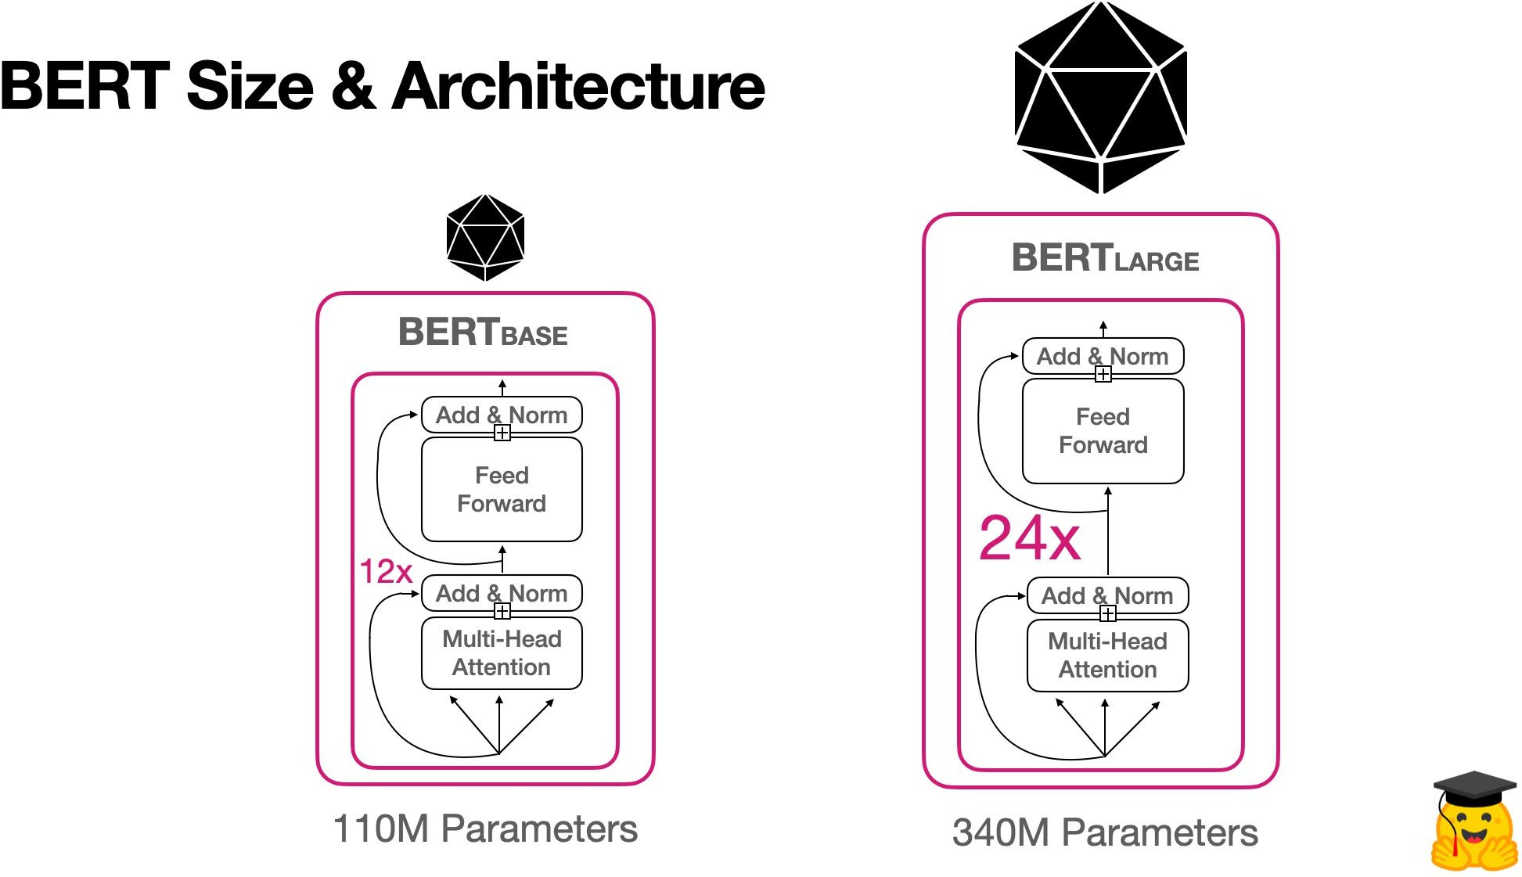
Under Hood
ML Architecture Parts
Definition
Parameters
Number of learnable variables/values available for the model
Number of Transformer blocks. A transformer block transforms a sequence of word representations to a sequence of contextualized words (numbered representations)
Layers of mathematical functions, located between the input and output, that assign weights (to words) to produce a desired result
Transformer Layers
Hidden Size
 | Transformer Layers | Hidden Size | Attention Heads | Parameters | Processing | Length of Training
BERTbase | 12 | 768 | 12 | 110M | 4 TPUs | 4d
BERTlarge | 24 | 1024 | 16 | 340M | 16 TPUs | 4d
Attention Heads
The size of a Transformer block
Processing
Type of processing unit used to train the model
Length of Training
Time it took to train the model
https://github.com/jessevig/bertviz
27

Slide 17
Other Models Based on Transformers

Slide 18
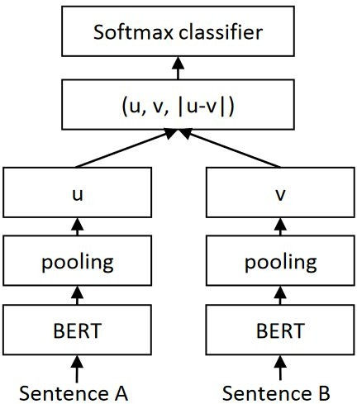
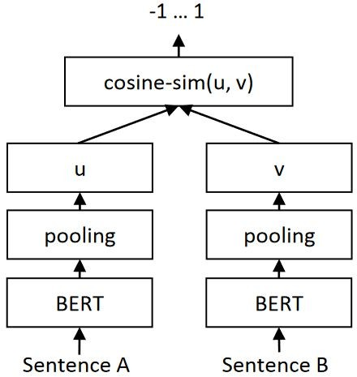
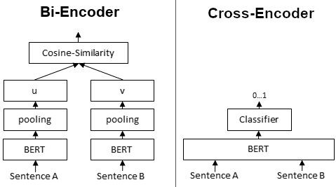
Sentence-BERT: Sentence Embeddings using Siamese BERT-Networks
A modification of the pretrained BERT network that use Siamese network structures to derive semantically meaningful sentence embeddings that can be compared using cosine-similarity
https://www.sbert.net/
29

Slide 19
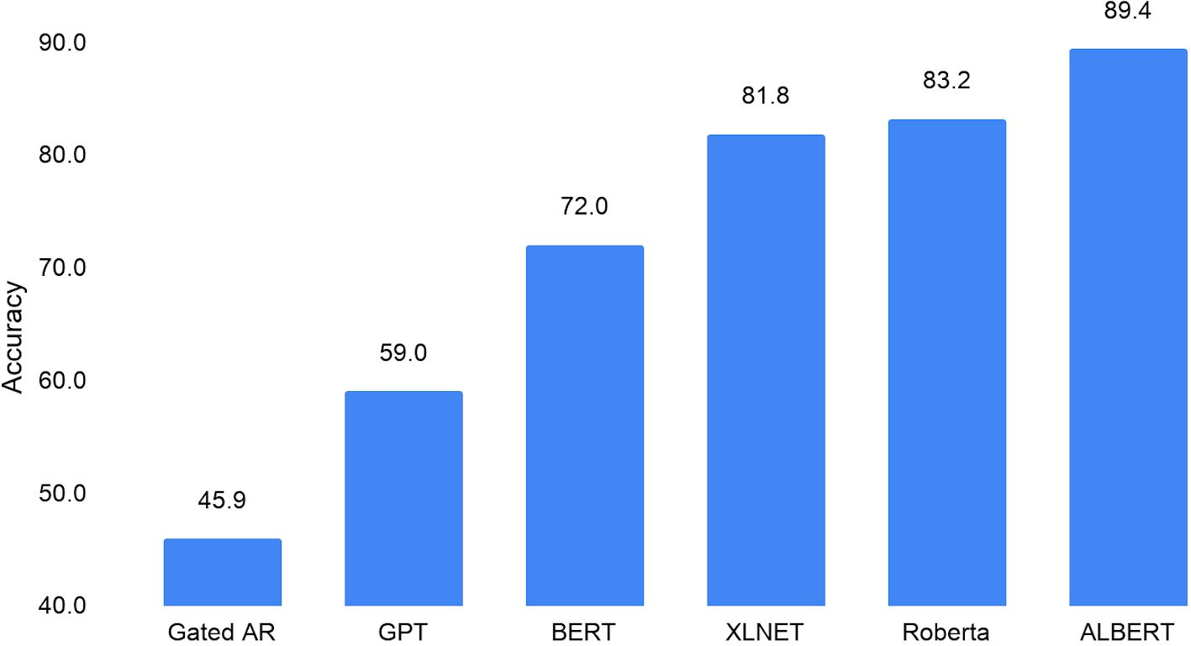
BERT-based Models
RoBERTa: Robustly Optimized BERT Approach
Facebook AI research team
They used 160 GB of text instead of the 16 GB dataset originally used to train BERT
Increased the number of iterations from 100K to 300K and then further to 500K
Dynamically changing the masking pattern applied to the training data
Removing the next sequence prediction objective from the training procedure
ALBERT, XLNET, ColBERT
Machine performance on the RACE challenge (SAT-like reading comprehension)
Liu et al. Roberta: A robustly optimized BERT pretraining approach, 2019
Lan et al. ALBERT: A LITE BERT for self-supervised learning of language representations, 2020
30

Slide 20
Generative Pre-trained Transformer (GPT)
GPT (Generative Pre-trained Transformer) is a series of language generation models developed by OpenAI. These models are based on the Transformer architecture (2018)
GPT-2 (Generative Pre-trained Transformer 2) was the second model in the GPT series, released in 2019. It was trained on a large corpus of internet text and was designed for language generation tasks such as question answering, and text summarization
GPT-3 (Generative Pre-trained Transformer 3) Released in 2020, with over 175 billion parameters, and was trained on a much larger and diverse dataset, including web pages, books, and scientific articles
GPT-4 (Generative Pre-trained Transformer 4) Released in 2023, a multimodal model which can accept image and text inputs and produce text outputs

Slide 21
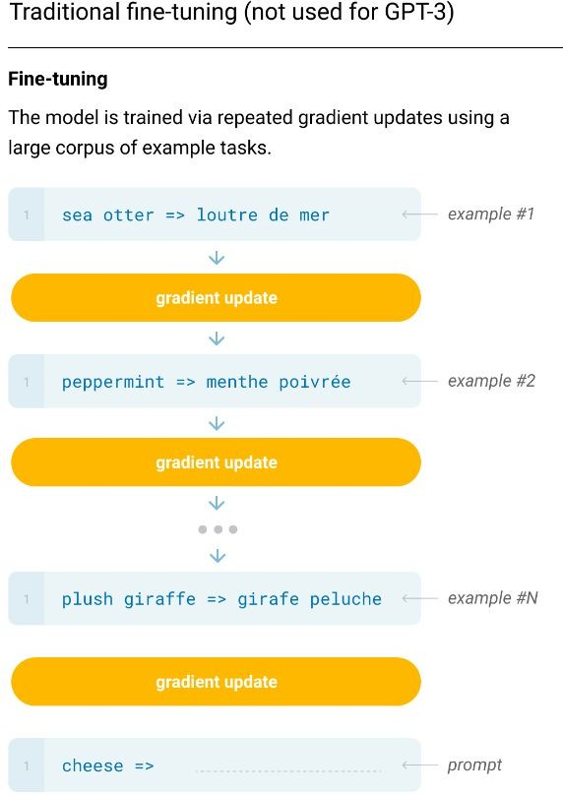
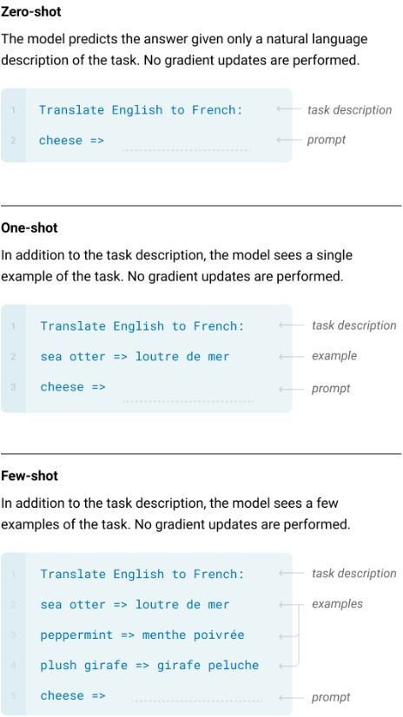
Zero-shot, One-shot and Few-shot, Contrasted with Traditional Fine-tuning
Language Models are Few-Shot Learners

Slide 22
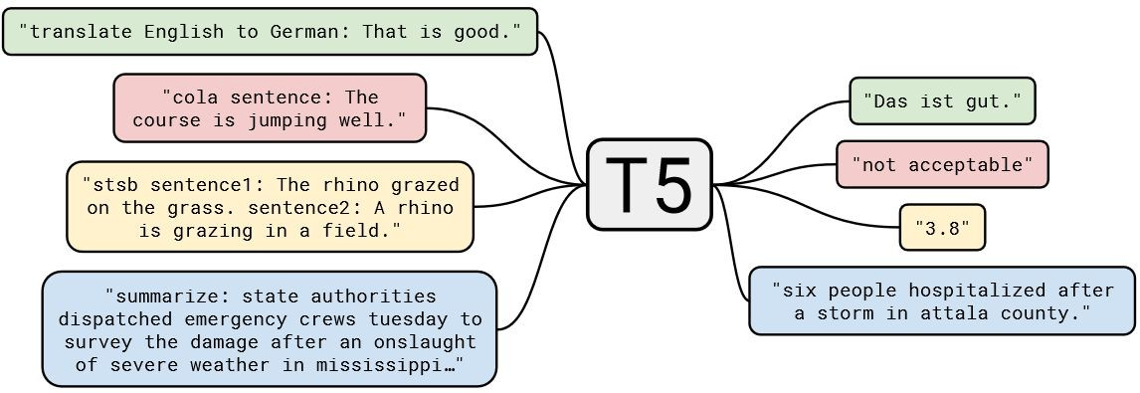
Text-to-Text Transfer Transformer (T5)
A diagram of the text-to-text framework (T5)
Every task, including translation, question answering, and classification, is cast as feeding T5 model text as input and training it to generate some target text

Slide 23

Thanks

